Slide 1
Graduation Rate Training
Training for LEA Registrars and Data Specialists

Slide 2
What is covered in this training?
Graduation Rate Overview
Deadlines
How Cohorts are Assigned
How a Graduating School is Assigned
Exit and High School Completion Codes
Checking Graduation Rates
Updating Records
Common Issues

Slide 3
Graduation Rate Overview
Every year a graduation rate is calculated for each high school in Utah.
This rate is calculated based on the data entered into the LEA’s Student Information System (SIS) and sent in to the state’s system (UTREx).

Slide 4
Graduation Rate Overview con…
Each student who attends high school is assigned a cohort. This cohort is the school year in which the student is expected to graduate.
At the end of their cohort year, a student is categorized as either a graduate, a non-graduate, or is excluded from graduation rate calculations.
A school’s graduation rate is the number of graduates divided by the number of students in the cohort minus the excluded students.
Graduation Rate= Graduates/(Cohort-Excluded)

Slide 5
Deadlines
ALL GRADUATION DATA IS DUE BY OCTOBER 10th. THERE ARE NO EXTENSIONS.
Graduation rates are published in December.
Graduation Rate Time Line
May June July August September October November December
Most Students Graduate
New School Year Starts
Oct 10: ALL exit/completion code updates for the previous school year are due
Official Graduation Rate Report Published

Slide 6

How Cohorts are Assigned
All students are placed in a cohort when they first enter 9th grade. They are expected to graduate 4 years later.
The cohort is set by the state based on the data in UTREx.
A student’s cohort can be looked up in the ‘Student Search’ feature in UTREx.
9th Grade 2013
Cohort Year
2015
2016
2017
2018
9th Grade 2015
Students starting school in Utah after 9th grade have a cohort calculated based on how many years until the student is expected to graduate: 10th = 3 years; 11th = 2 years; 12th = 1 year.

Slide 7
How a Graduating School is Assigned
Each student can only be included in one school’s graduation rate. There are specific rules the state uses to determine in which school’s rate a student should be included. In general, a student is included in the rate of the last school they attended.
The following slides show a few different scenarios.

Slide 8


Scenario 1:
A student attends Jr. High and then moves on to High School. The student only ever attends one high school. The student is included in the High School’s graduation rate.
This is the most common scenario.
A
B
B
Jr. High
High School
High School Credited with Graduation

Slide 9
Scenario 2:
A student attends two different high schools. The student attends one high school in 2014 and 2015 and then transfers to another high school in 2016. The student is included in the last high school’s graduating rate.
A
B
B
High School
Attended 2014 & 2015
High School
Attended 2016
High School B Credited with Graduation

Slide 10
Scenario 3:
A student attends two schools simultaneously. One school indicates they have graduated the student. The student is included in the graduating school’s rate.
Attended 2016
Submitted
Graduation
A
A
School A Credited with Graduation
Attended 2016
No Graduation
B

Slide 11
Scenario 4:
A student attends two schools simultaneously. Neither school graduates the student. One school indicates they are ‘not the school of record’. The student is included in the rate for the school marked as the ‘school of record’.
Attended 2016
Submitted
‘Not School of Record’
A
B
Attended 2016
School of Record
School B Credited with Graduation
B
A school will not receive regular funding for a student if the school is marked as ‘Not School of Record’. A school should only be marked as ‘not school of record’ in a few circumstances. Typically it is marked if the school is an SOEP provider.

Slide 12
Scenario 5:
A student attends two high schools at the same time. Neither school graduates the student, and neither school submits as ‘not school of record’. The school with the latest Exit Date (as entered in the SIS system) will be the graduating school.
Attended 2016
Exit Date: 6/03
A
B
School B Credited with Graduation
Attended 2016
Exit Date: 6/28
B

Slide 13
Exit and High School Completion Codes
A high school completion code indicates whether or not a student graduated.
If a student does not have a high school completion code it should be because they exited school before the end of their senior year. In this case, the student should have an exit code.
These codes are entered into the LEA’s SIS. They are then transmitted to the state’s system, UTREx. Typically this submission occurs automatically each night.

Slide 14
A list of Possible High School Completion Codes:
Code | Description
AO | Aged Out of Special Education
CT | Certificate of Completion
DO | Dropout
G3 | Graduated UAA/DLM
GC | Adult Education High School Diploma – Carnegie Units
GG | Utah High School Completion Diploma - GED
GM | Graduate with Military Provision (Utah Code 53A-11-1404)
GP | Graduation Pending
GQ | Basic High School Diploma with Advanced Math Requirement
GR | Basic High School Diploma
RT | Retained Senior

Slide 15
List of Possible Exit Codes:
Code | Description
11 | Early Graduate – 9th, 10th, or 11th grade. | TH* | Transferred to Home Schooling
AE | Transferred to Adult Ed. | TR* | Transferred to a Charter School
DE | Death | TS* | Transferred to a Public School within the State
DO | Dropout | TT* | Transferred tracks within school.
EX | Expelled | TO | Transferred out of State
FE | Foreign Exchange Student | TP | Transferred to Private School
GE | Exited to Take GED | T1,T2 | Early Graduate Senior Term 1 or 2
HE | Transferred to Higher Ed | UC | Transferred to UCAT
Q1, Q2, Q3 | Early Graduate - 1st, 2nd, or 3rd Quarter of Senior Year | UN | Unknown
TC | Transferred out of Country | WD | Withdrawn
TD* | Transferred within District | WM | Withdrawn Medical
*If the final code for a student is one of these transfer codes, and no other public school record can be found, then the student’s final status will be recoded by the state as unknown.

Slide 16
Final Codes
A student is placed in one of three categories based on their final completion or exit code.
Graduates
Graduate w/Basic HS Diploma
Graduate Carnegie
Graduate Military
Early Graduate
Graduate w/ Basic HS Diploma with Advanced Math Requirement
Non-Graduates
Dropout (Unknown)
Expelled/Suspended
Withdraw
Graduate Pending
Transfer to Adult Ed, Higher Ed, or UCAT
Retained Senior
Aged Out
Completion Certificate
GED
Graduated UAA/DLM
Excluded
Foreign Exchange Student
Transfer out of State/Country
Transfer to Home/Private School
Death
Withdraw Medical

Slide 17
Final Codes Con…
Utah reports will divide Non-Graduates into three subgroups: Dropouts, Continuing Students, and Other Completers.
Non-Graduates
Dropout
Expelled/Suspended
Withdraw
Graduate Pending
Transfer to Adult Ed
Higher Ed, or UCAT
Retained Senior
Aged Out
Completion Certificate
GED
Dropouts
Continuing Students
Other Completers

Slide 18
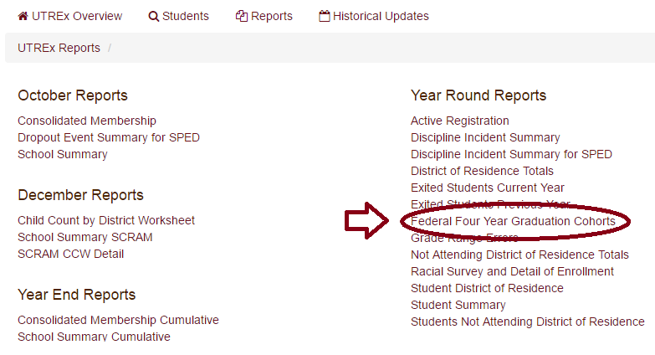
Checking Graduation Rates
To check your graduation rates before publication, access the ‘Federal Four Year Graduation Cohorts’ report in UTREx. If you do not have UTREx access contact your LEA’s UTREx Administrator.
This report is updated every time your LEA submits data to UTREx.

Slide 19
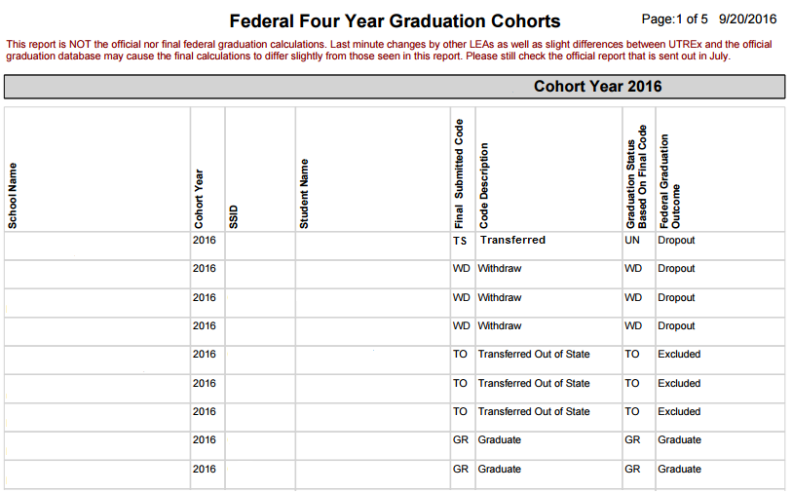
Example Report:
This is the code entered into your SIS system.
This is how the student is counted in the graduation rate.

Slide 20
Updating Records
If you need to update an exit/completion code in the current school year simply update the code in your SIS system. The next time data is submitted to UTREx this code will be updated.
If you need to update an exit/completion code from the previous school year submit an x-residency (s1-x) record. An s1-x record will find the previous record for the student and update it.

Slide 21
S1-X Record
X-residency records are essentially normal enrollment records, submitted with the current year data, with the resident status marked as ‘X’.
The ‘X’ in the resident status field indicates this record is being submitted only to update the exit or high school completion code.
If you need further information on how to enter a X-residency record please contact your LEA’s IT department.

Slide 22
Common Issue 1
Issue | Possible Reason | Possible Resolutions
Student transfers to another public school but is still showing on your school’s graduation report. | After a student transfers out of your school the student will remain on your graduation report until the state receives a record from the new school to which the student transferred. | Check that the student actually transferred to a public school. If the student went to homeschool, a private school, or out-of-state then update the exit code accordingly. Verify which SSID the new public school used. If they used a different SSID then request an SSID merge. If the student meant to transfer to another school but ended up dropping out before the new school officially enrolled the student, then the student will remain on your school’s graduation report.

Slide 23
Common Issue 2
Issue | Possible Reason | Possible Resolutions
A student is showing in a different cohort than when the student graduated or will graduate (i.e. showing in the 2016 cohort when they will graduate in 2017). | A previous grade level was incorrectly submitted OR student repeated a grade. | If a grade was previously entered incorrectly, this could cause the cohort year to be set incorrectly. Contact your UTREx administrator to submit a historical update record to fix both the grade and cohort year. If a student repeated a grade in high school, then their cohort year remains the same. A cohort year is based on the first time the student entered 9th grade.

Slide 24
Common Issue 3
Issue | Possible Reason | Possible Resolutions
The student’s exit code was updated in the school’s SIS system but is not reflected in the state’s graduation rate. | The exit code was updated after the school year was complete (June 30th). | Submit an s1-x record to update the final code in UTREx. After submitting the data, check the ‘Federal Four Year Cohorts Report’ in UTREx to make sure the update went through correctly.

